Slide 1


One Swag
Syed Mazhar
Ramalingam Kothandam

Slide 2
Why “One Swag”
1000’s of Events across the Globe
Unorganized data
Great opportunity to roll-out Dynamics 365 quickly and increase ACR
Potential to up-sell other products
Centralized
History
Analysis

Slide 3
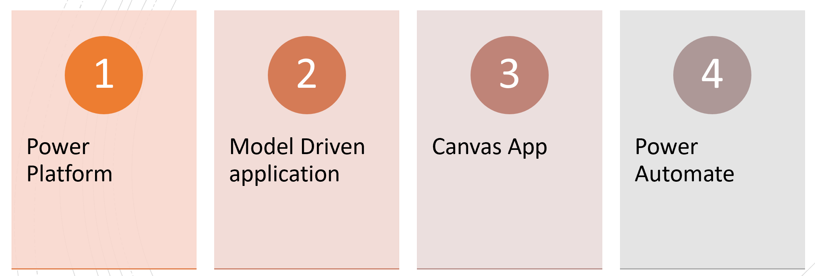
What is OneSwag…?
Swag Management System
Technologies Leveraged
Power Platform
Model Driven Application
Canvas App
Power Automate

Slide 4

Who needs “OneSwag”…?
Events
B2B
B2C
Internal Team
Onboarding of Resources

Slide 5
Features Supported
Plan Swag Distribution in Mega or Virtual Events
Booth Management
Plan, Prepare, Design Swag Boxes
Swag Management
Swag Tracking
End User Visibility on Swag

Slide 6
Ready to Use Application
Swag Management System – Model Driven Application developed with no code approach.
Swag Tracker – Canvas Application developed for end users to see swags assigned and provide additional information for swag processing

Slide 7
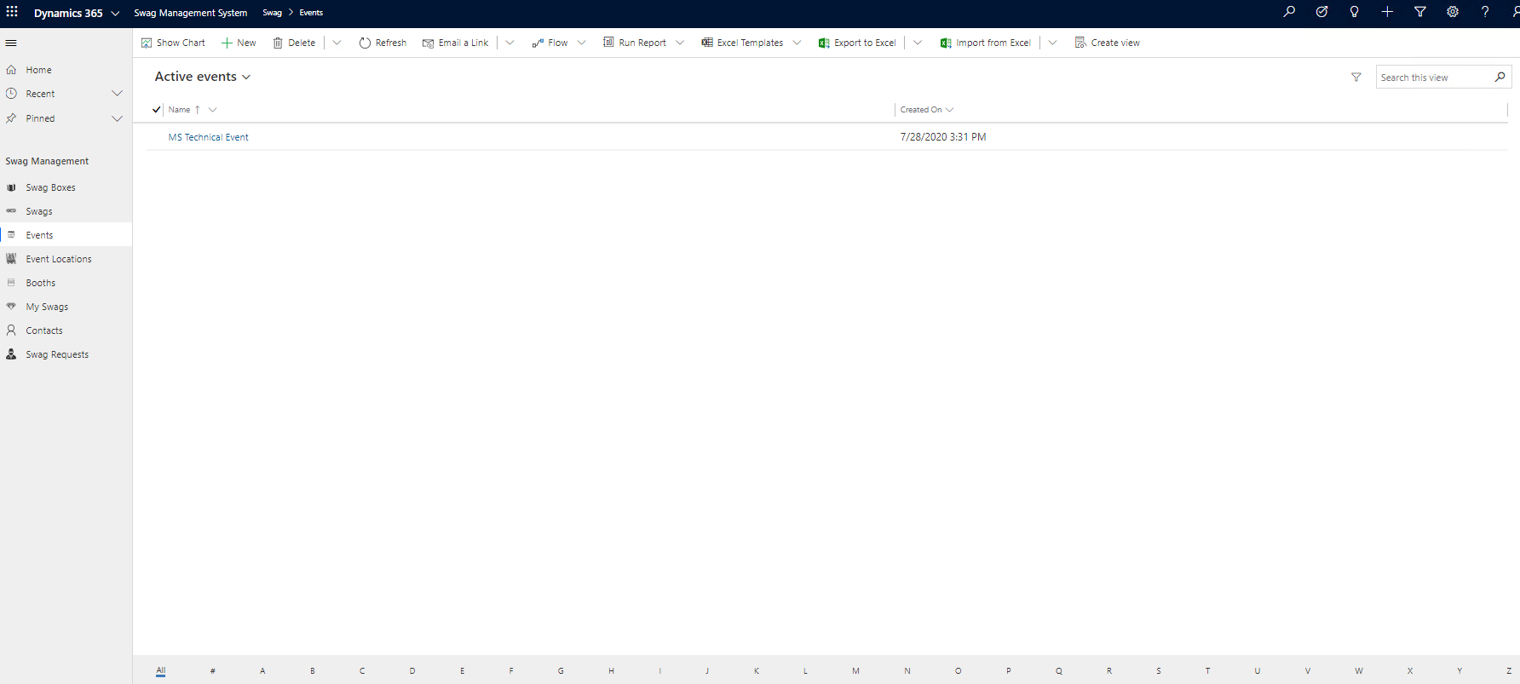
Glimpse of Swag Management System

Slide 8
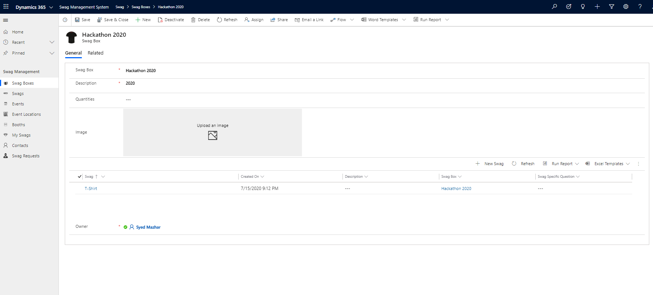
Create Swag Boxes – Collection of Goodies

Slide 9
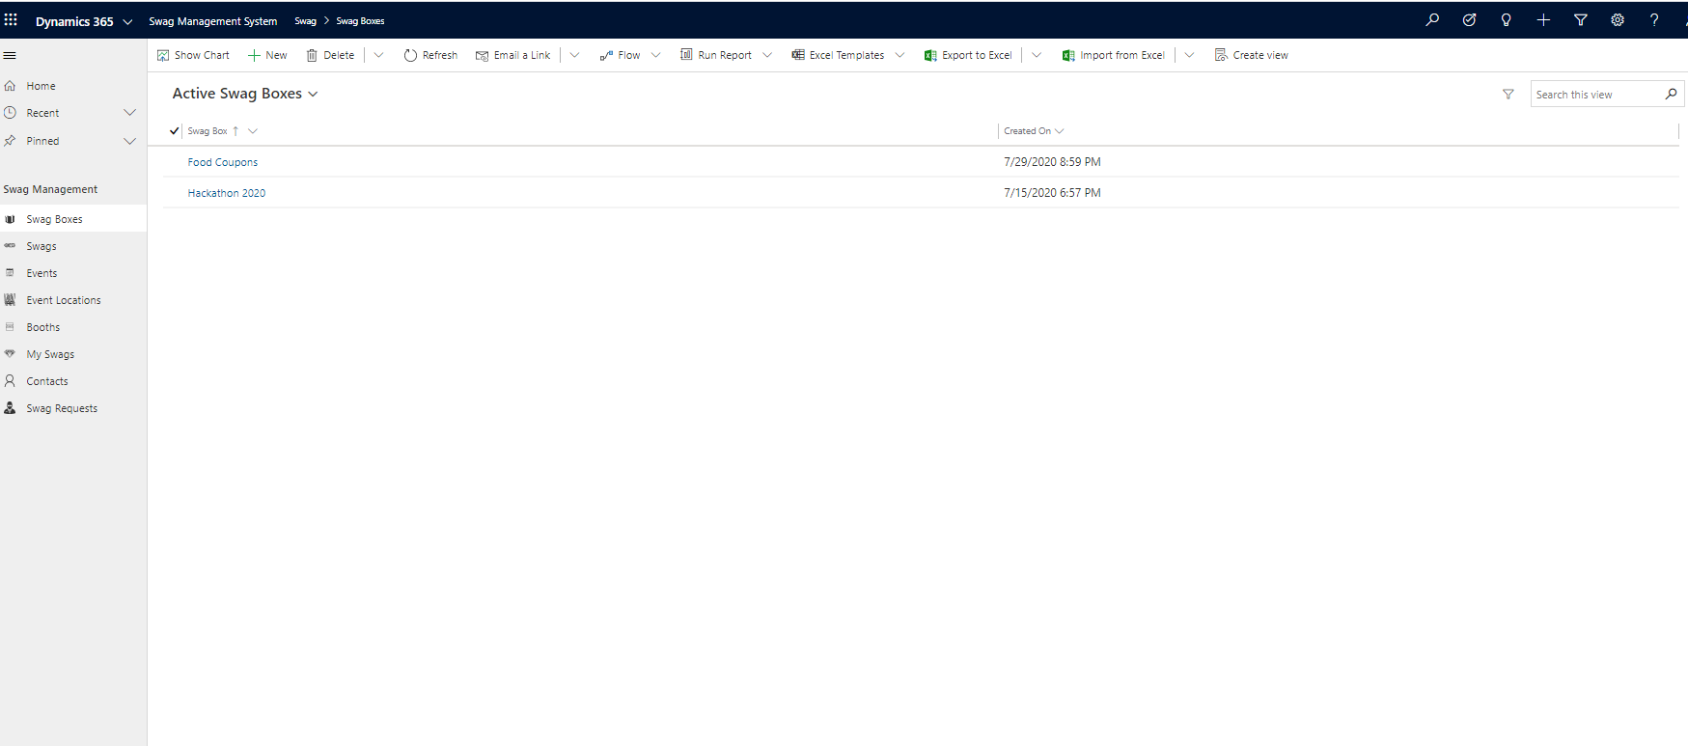
View Swag Boxes

Slide 10
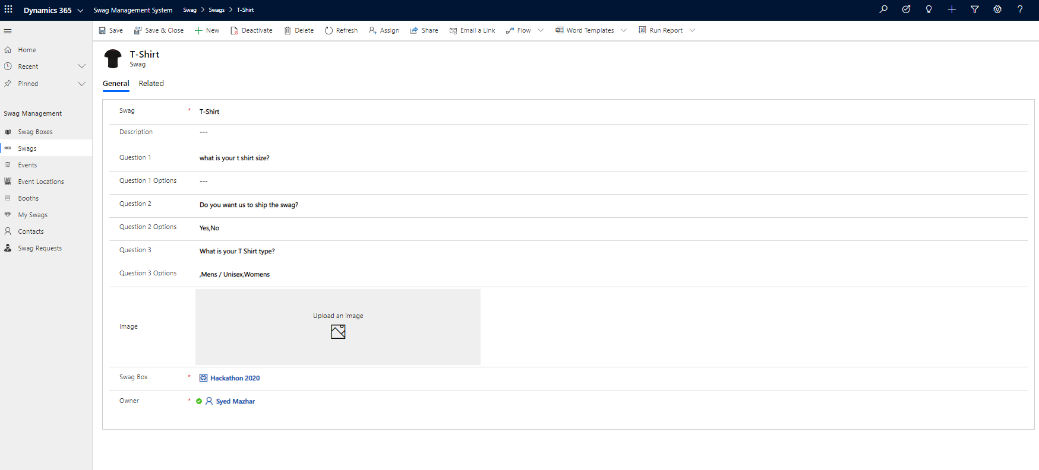
Fill Swag Box with Swags / Goodies

Slide 11
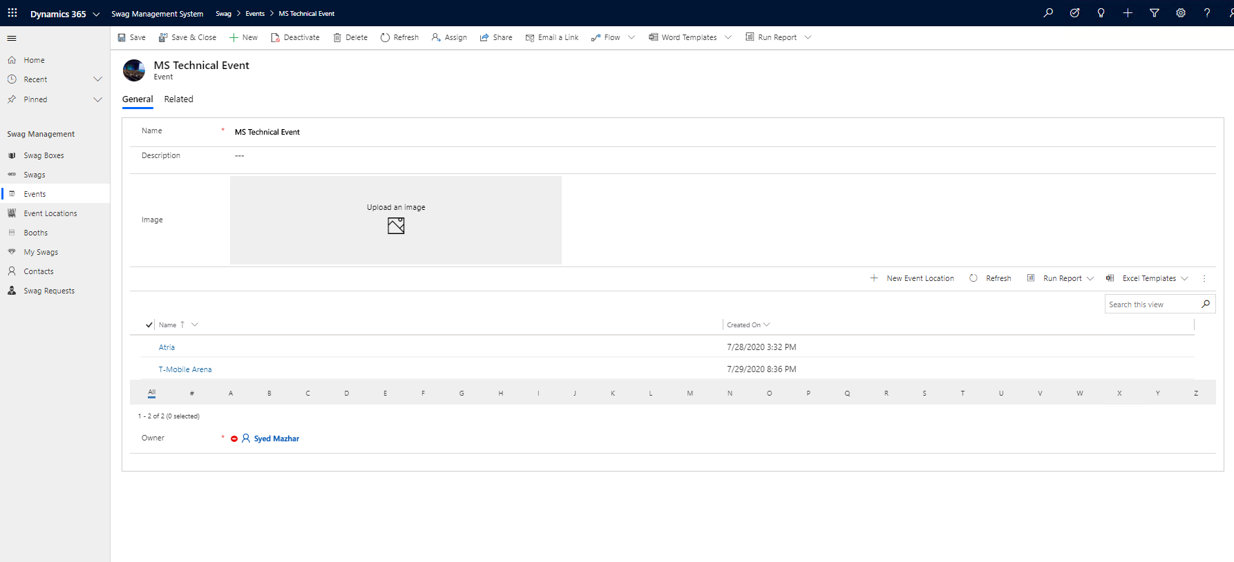
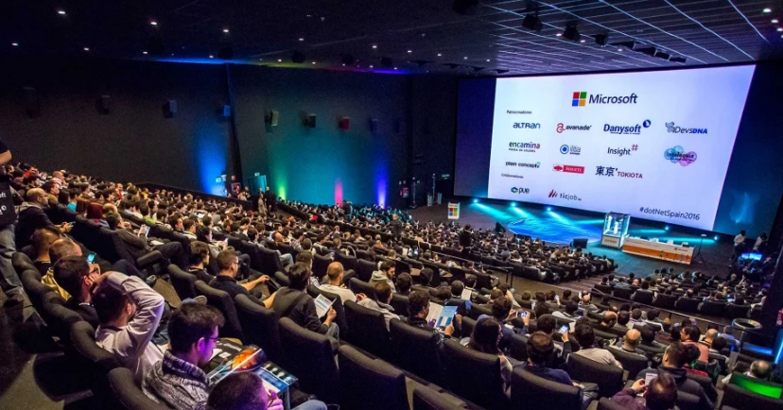
Configure mega events for Swag Distribution

Slide 12
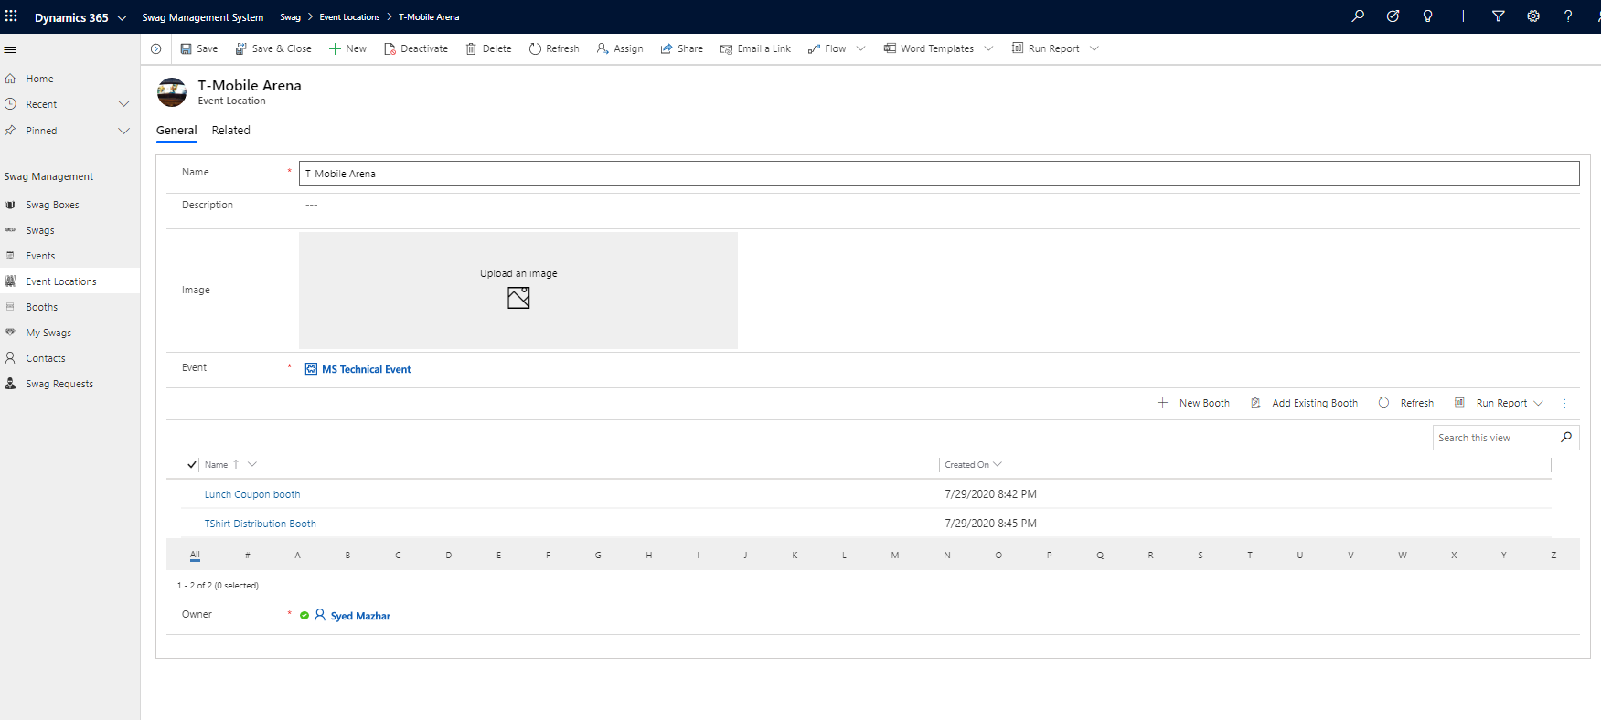
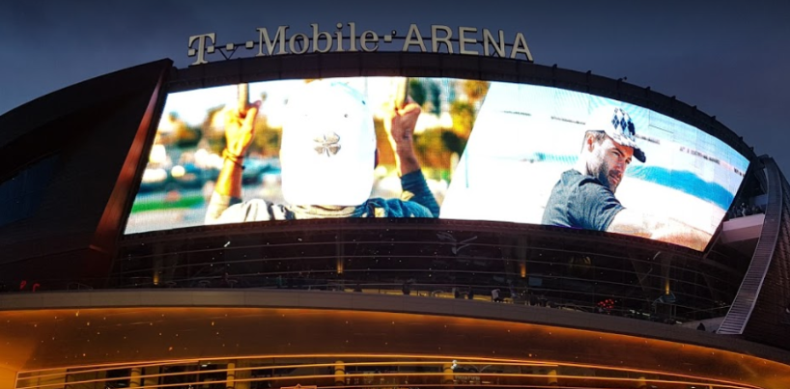
Configure event locations for Swag Distribution

Slide 13
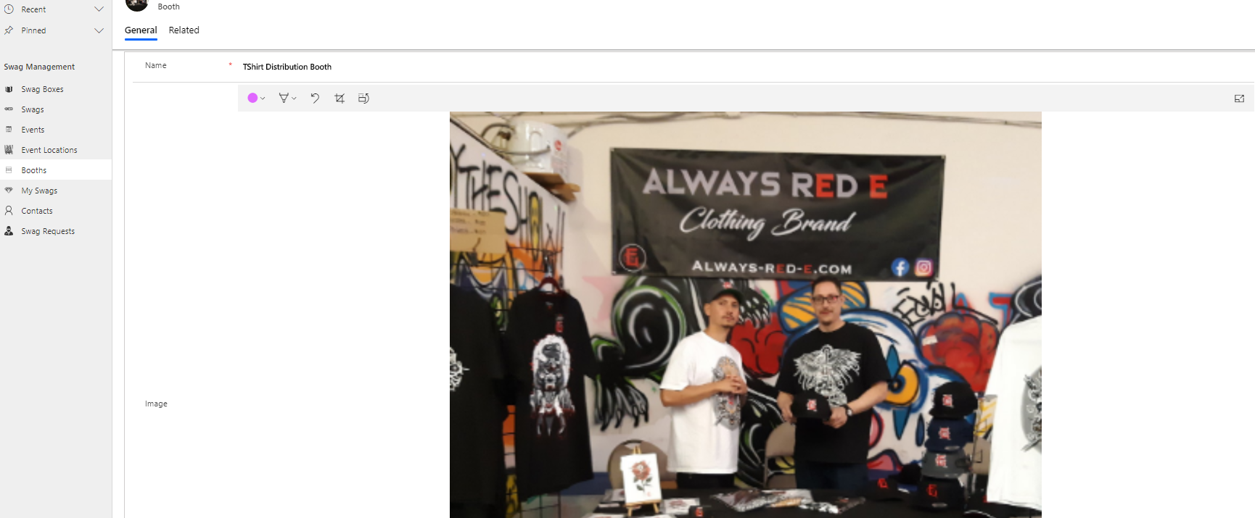
Setup Booths Event Location

Slide 14
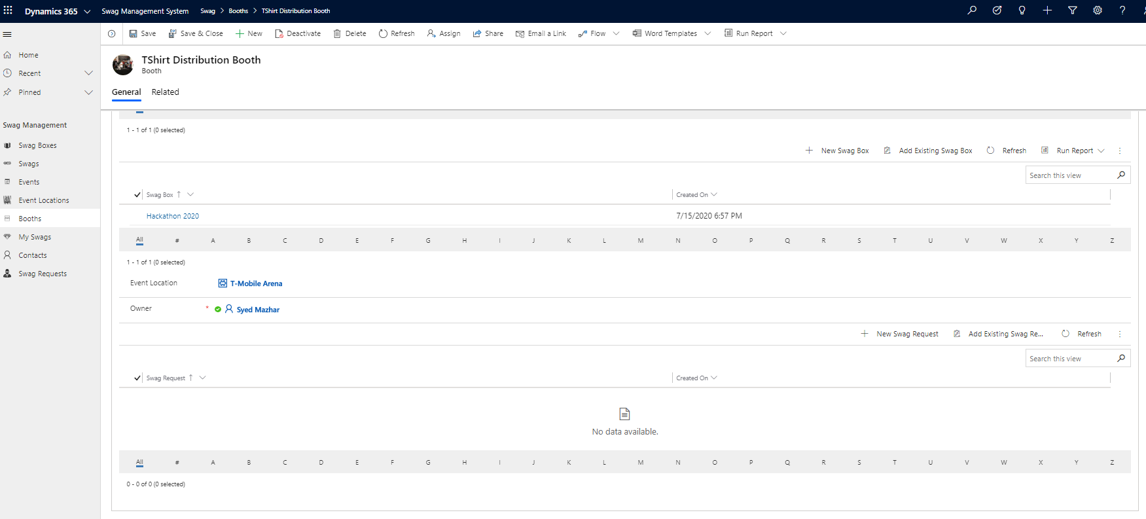
Setup Booth Owners and Swag Boxes

Slide 15
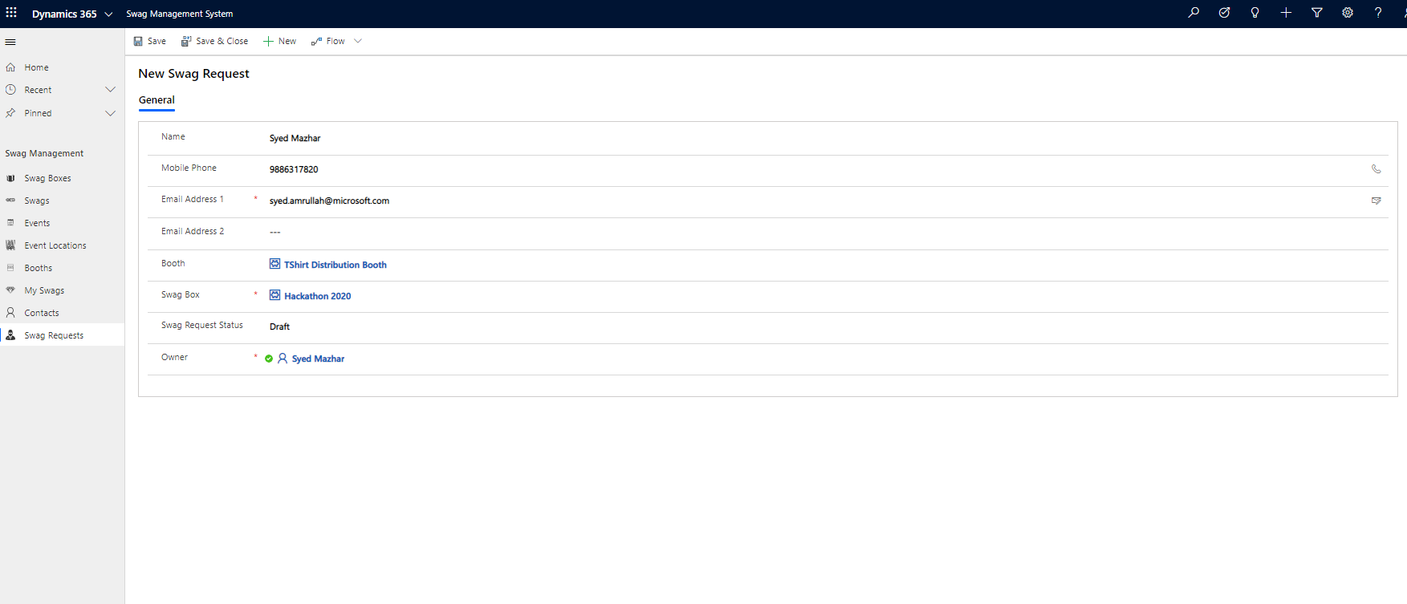
Distribute Swag From Booth

Slide 16
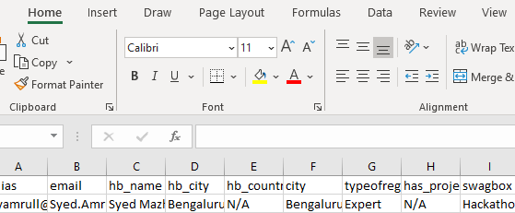
Distribute Swags using Power of Excel

Slide 17
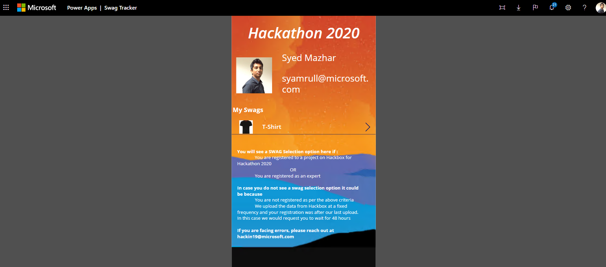
Swag Tracker – End user visibility on Swags assigned to him

Slide 18
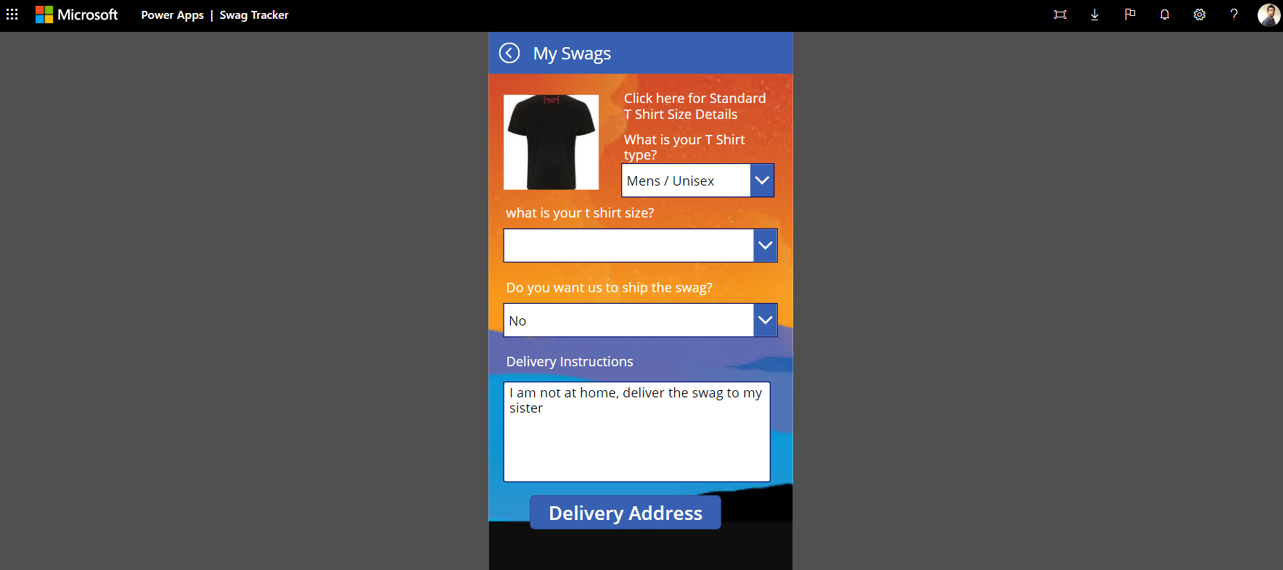
Swag Tracker – End user can update delivery information

Slide 19
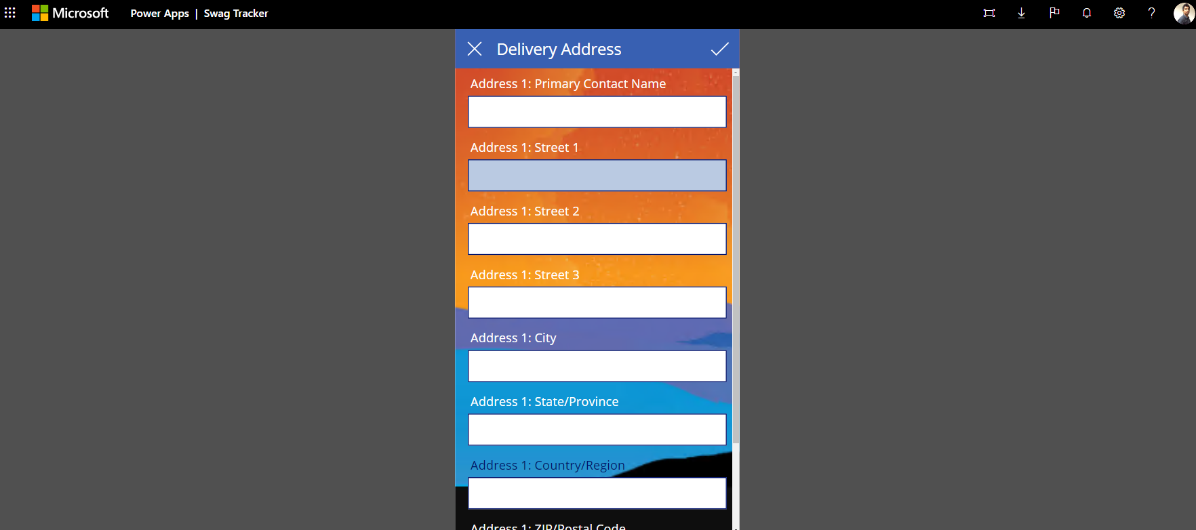
Swag Tracker

Slide 20
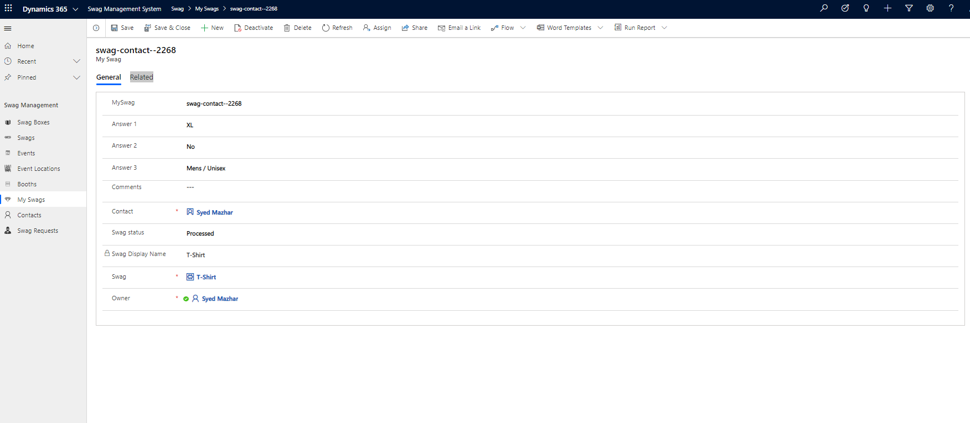
Swag status – View status of Swags

Slide 21
What is next…?
Working on ISV certification
01
Making it available in AppSource for entire Power Platform
02

Slide 22
Product Roadmap
Geo-location tagging
Nearest booth to pickup goodies
Id Card detection and automatic request creation
Print the label of the address
integration with registration portal
Business card reader integration

Slide 23
Known issues
Minimize CRM onboarding time

Slide 24
Demo
Speaker name

